Slide 1



Learning Domain-Invariant Relationship with Instrumental Variable for Domain Generalization
Junkun Yuan¹, Xu Ma¹ , Kun Kuang¹ , Ruoxuan Xiong² , Mingming Gong³ , and Lanfen Lin¹
¹ Zhejiang University
² Emory University
³ The University of Melbourne

Slide 2
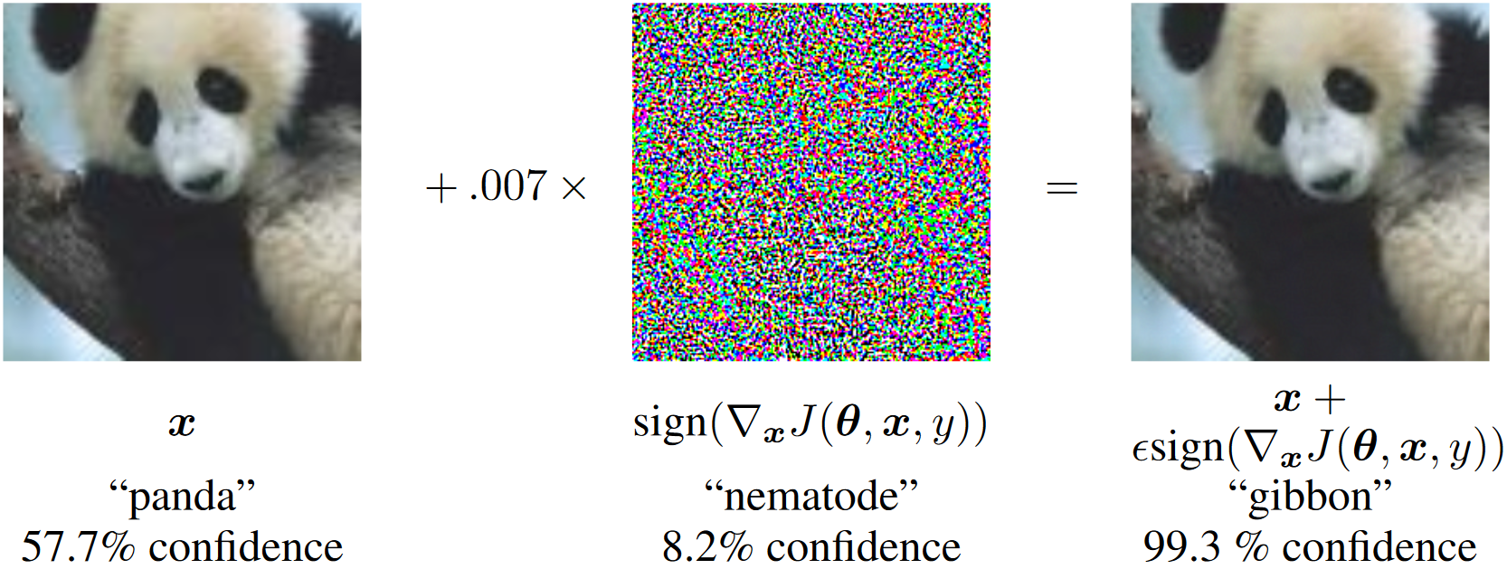
Deep Models Lack Robustness and Generalization
Fast Gradient Sign Method (FGSM) ^{[1]}
[1] Goodfellow I J, Shlens J, Szegedy C. Explaining and harnessing adversarial examples[J]. arXiv preprint arXiv:1412.6572, 2014.

Slide 3
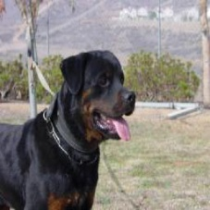
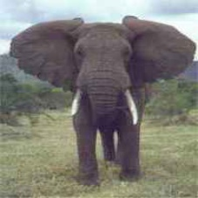
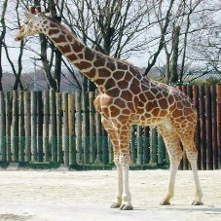
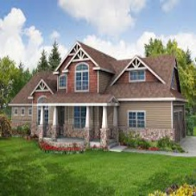
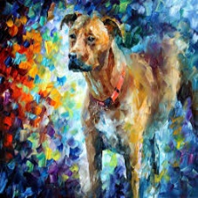
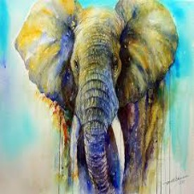
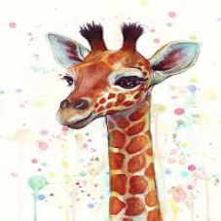
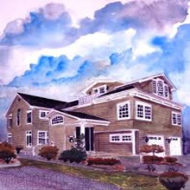
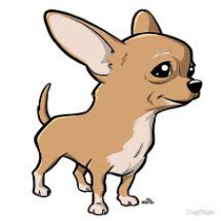
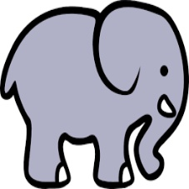
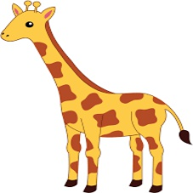

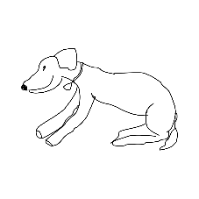
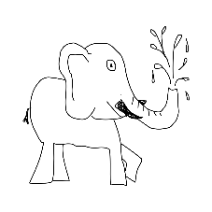
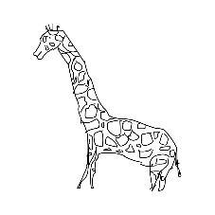
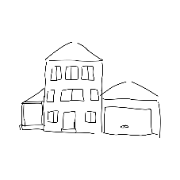
Deep Learning Algorithms Mostly Rely on I.I.D. Assumption
✔
？
？
Training Dataset/Domain
Deep Models
？
Test Datasets/Domains

Slide 4
Domain Generalization (DG): Learning Invariant Knowledge from Multiple Source Domains to Unknown Target Domains
Source Domains
Target Domains
Domain a
Domain a
Performance A
I.I.D.
Domain b
Domain d
Performance D
Model
Stable Generalization
Domain c
Domain e
Performance E
…
…
…
Domain Q
Domain P
Performance N

Slide 5
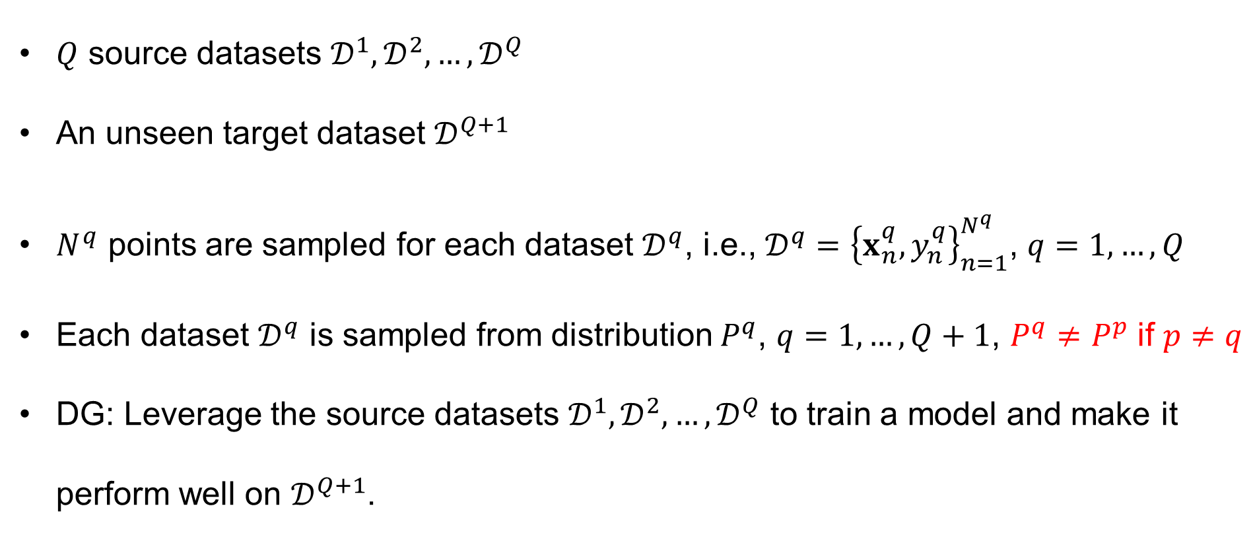
Problem Setup of Domain Generalization (DG)
$Q$ source datasets $𝒟^{1}, 𝒟^{2},…,𝒟^{Q}$
An unseen target dataset $𝒟^{Q+1}$
$N^{q}$ points are sampled for each dataset $𝒟^{q}$, i.e., $𝒟^{q}={\left\{x_{n}^{q},y_{n}^{q}\right\}}_{n=1}^{N^{q}}$, $q=1,…,Q$
Each dataset $𝒟^{q}$ is sampled from distribution $P^{q}$, $q=1,…,Q+1$, $P^{q}≠P^{p}$ if $p≠q$
DG: Leverage the source datasets $𝒟^{1}, 𝒟^{2},…,𝒟^{Q}$ to train a model and make it perform well on $𝒟^{Q+1}$.

Slide 6
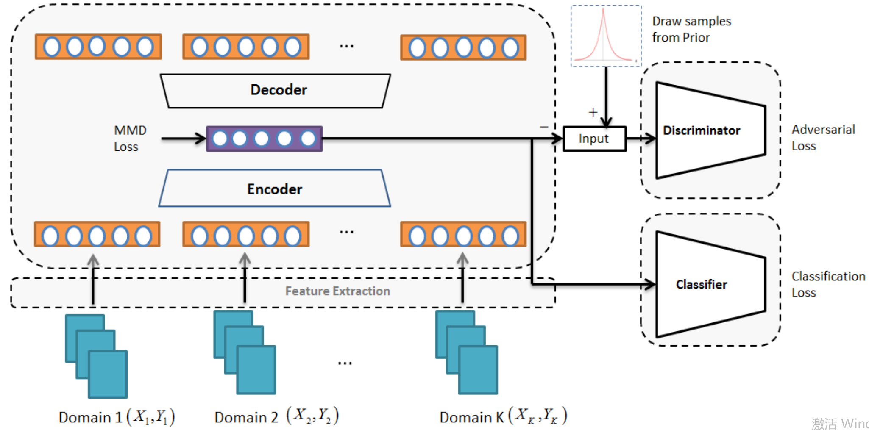
Representative Works for DG
Domain invariant representation learning. ^{[2]}
[2] Li H, Pan S J, Wang S, et al. Domain generalization with adversarial feature learning[C]//Proceedings of the IEEE Conference on Computer Vision and Pattern Recognition. 2018: 5400-5409.

Slide 7
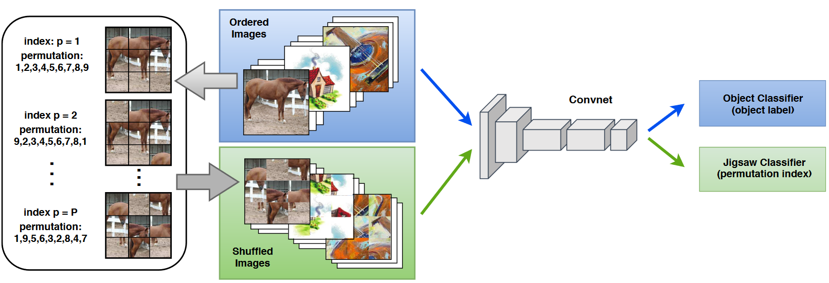
Representative Works for DG
Domain augmentation. ^{[3]}
[3] Carlucci F M, D'Innocente A, Bucci S, et al. Domain generalization by solving jigsaw puzzles[C]//Proceedings of the IEEE/CVF Conference on Computer Vision and Pattern Recognition. 2019: 2229-2238.

Slide 8
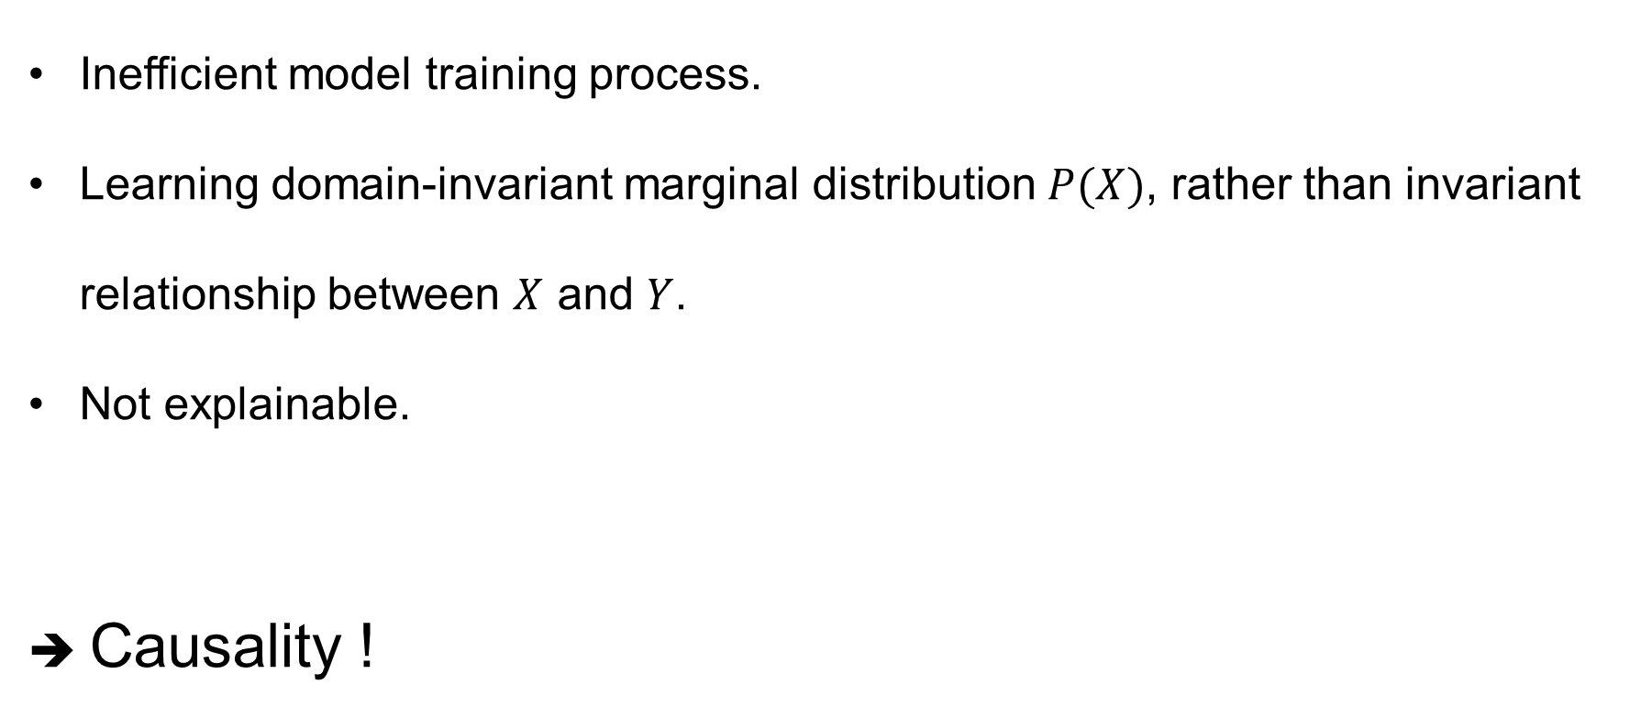
Problems of Existing DG Works
Inefficient model training process.
Learning domain-invariant marginal distribution $P(X)$, rather than invariant relationship between $X$ and $Y$.
Not explainable.
➔ Causality !

Slide 9
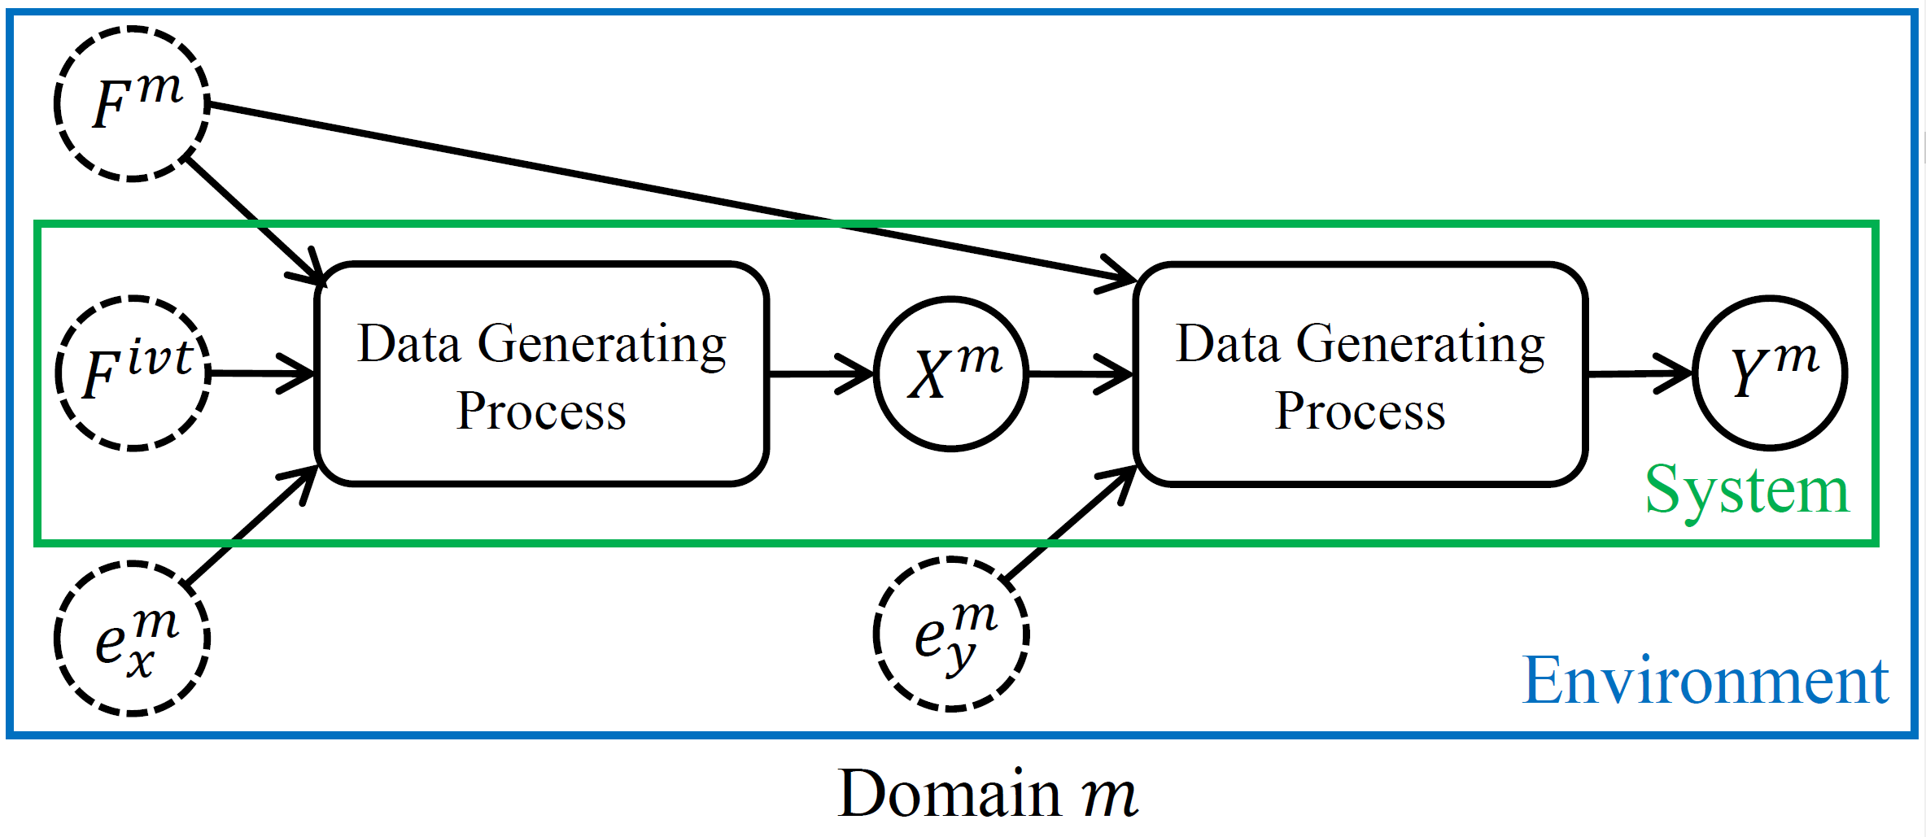
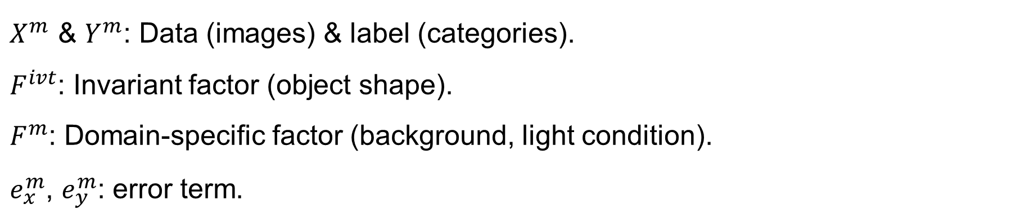
Data Generating Process (DGP) Assumption
$X^{m}$ & $Y^{m}$: Data (images) & label (categories).
$F^{ivt}$: Invariant factor (object shape).
$F^{m}$: Domain-specific factor (background, light condition).
$e_{x}^{m}$, $e_{y}^{m}$: error term.

Slide 10
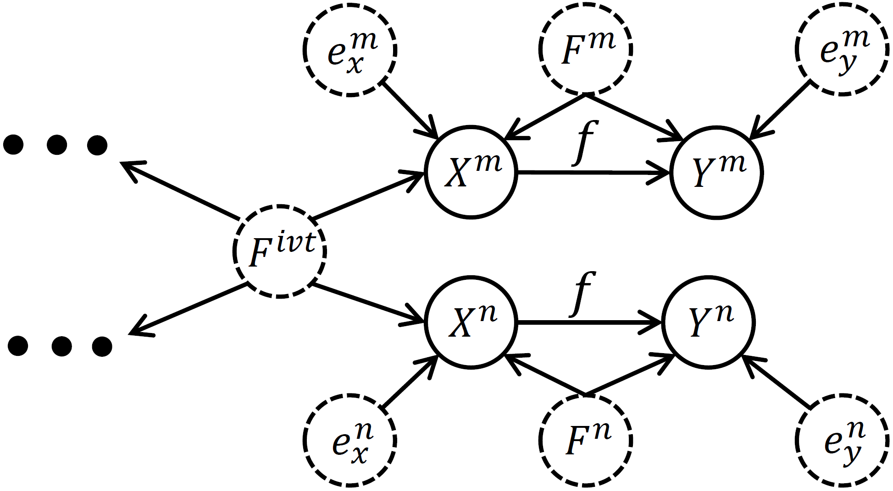
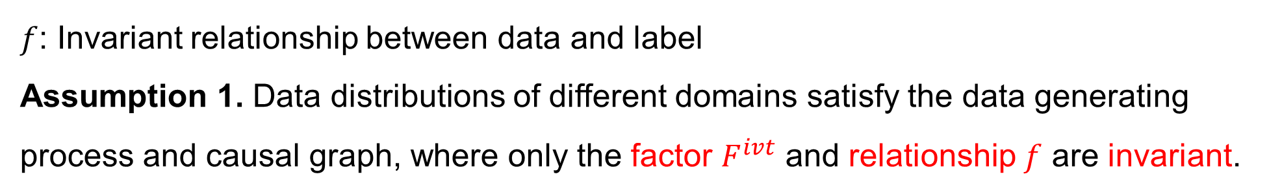
Robust Perception of Human & Invariant Relationship Assumption
$f$: Invariant relationship between data and label
Assumption 1. Data distributions of different domains satisfy the data generating process and causal graph, where only the factor $F^{ivt}$ and relationship $f$ are invariant.

Slide 11
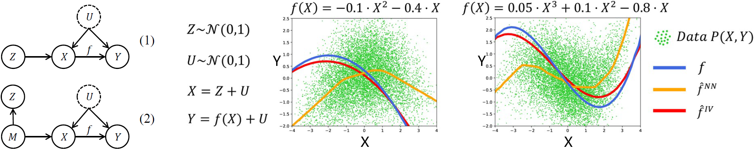
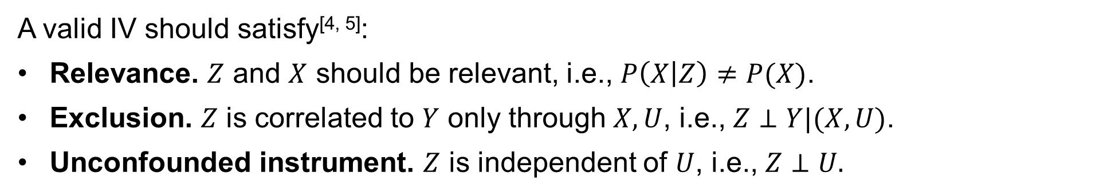
Preliminary of Instrumental Variable (IV)
A valid IV should satisfy^{[4, 5]}:
Relevance. $Z$ and $X$ should be relevant, i.e., $P\left(X | Z\right)≠P(X)$.
Exclusion. $Z$ is correlated to $Y$ only through $X, U$, i.e., $Z⊥Y|(X,U)$.
Unconfounded instrument. $Z$ is independent of $U$, i.e., $Z⊥U.$
[4] Pearl J. Causality[M]. Cambridge university press, 2009.
[5] Hartford J, Lewis G, Leyton-Brown K, et al. Deep IV: A flexible approach for counterfactual prediction[C]//International Conference on Machine Learning. PMLR, 2017: 1414-1423.

Slide 12
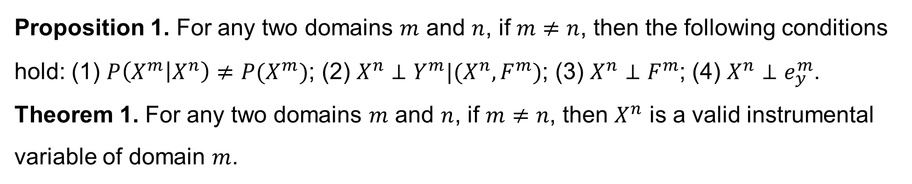
Instrumental Variable for Domain Generalization Problem
Proposition 1. For any two domains $m$ and $n$, if $m≠n$, then the following conditions hold: (1) $P\left(X^{m} | X^{n}\right)≠P(X^{m})$; (2) $X^{n}⊥Y^{m}|(X^{n},F^{m})$; (3) $X^{n}⊥F^{m}$; (4) $X^{n}⊥e_{y}^{m}$.
Theorem 1. For any two domains $m$ and $n$, if $m≠n$, then $X^{n}$ is a valid instrumental variable of domain $m$.

Slide 13
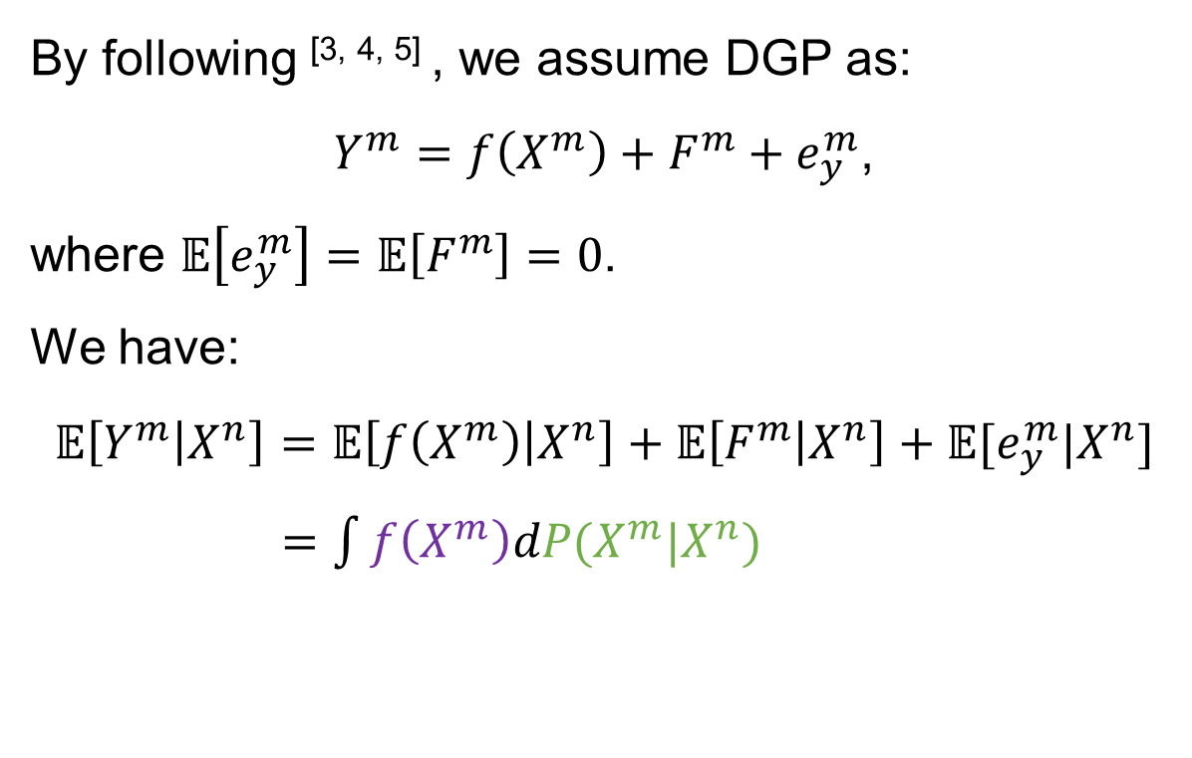
Two-stage Method to Learn Domain-Invariant Relationship
By following ^{[3, 4, 5]} , we assume DGP as:
$Y^{m}=f\left(X^{m}\right)+F^{m}+e_{y}^{m}$,
where $𝔼\left[e_{y}^{m}\right]=𝔼\left[F^{m}\right]=0$.
We have:
$$𝔼\left[Y^{m} | X^{n}\right]=𝔼\left[f\left(X^{m}\right) | X^{n}\right]+𝔼\left[F^{m} | X^{n}\right]+𝔼[e_{y}^{m}|X^{n}]$$
$=\int{f\left(X^{m}\right)dP(X^{m}|X^{n})}$
[5] Hartford J, Lewis G, Leyton-Brown K, et al. Deep IV: A flexible approach for counterfactual prediction[C]//International Conference on Machine Learning. PMLR, 2017: 1414-1423.
[6] R. Singh, M. Sahani, and A. Gretton. Kernel instrumental variable regression. In Advances in Neural Information Processing Systems (NeurIPS), pages 4593–4605, 2019.
[7] A. Bennett, N. Kallus, and T. Schnabel. Deep generalized method of moments for instrumental variable analysis. In Advances in Neural Information Processing Systems (NeurIPS), pages 3564–3574, 2019.

Slide 14
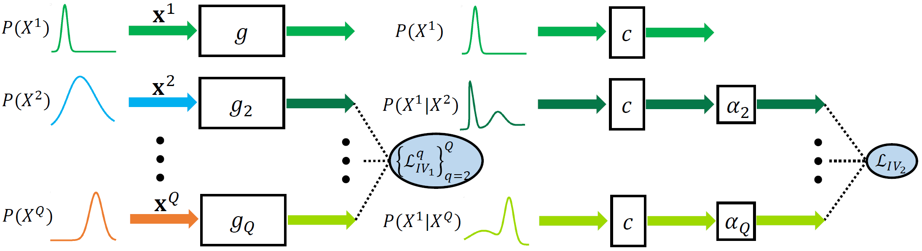
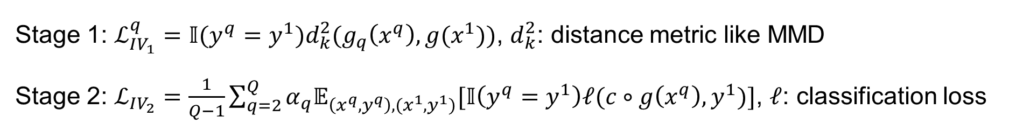
Domain Invariant Relationship with Instrumental Variable
Stage 1: $ℒ_{IV_{1}}^{q}=𝕀(y^{q}=y^{1})d_{k}^{2}(g_{q}\left(x^{q}\right),g(x^{1}))$, $d_{k}^{2}$: distance metric like MMD
Stage 2: $ℒ_{IV_{2}}=\frac{1}{Q−1}\sum_{q=2}^{Q}{α_{q}𝔼_{\left(x^{q},y^{q}\right),(x^{1},y^{1})}[𝕀\left(y^{q}=y^{1}\right)ℓ(c∘g\left(x^{q}\right),y^{1})]}$, $ℓ$: classification loss

Slide 15
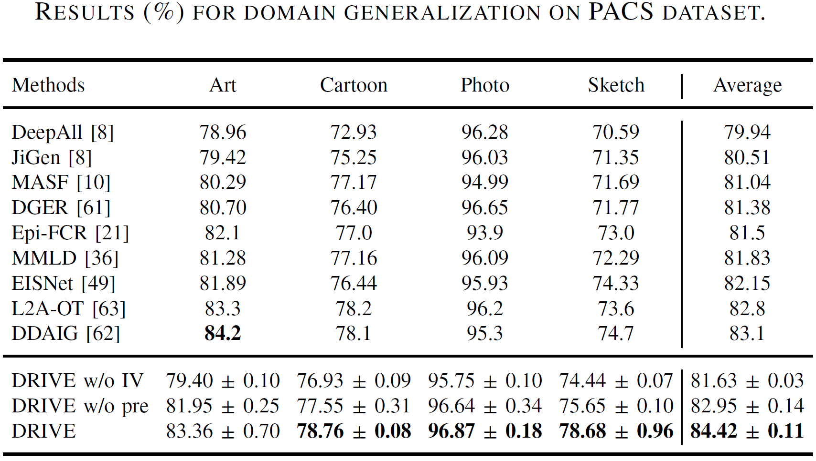
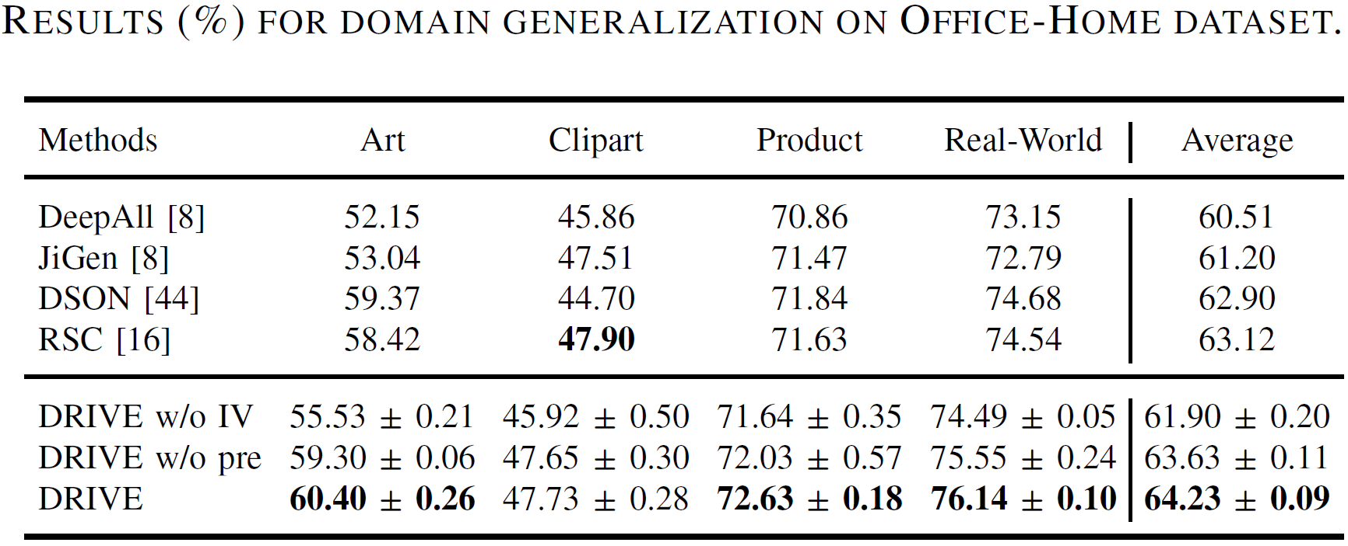
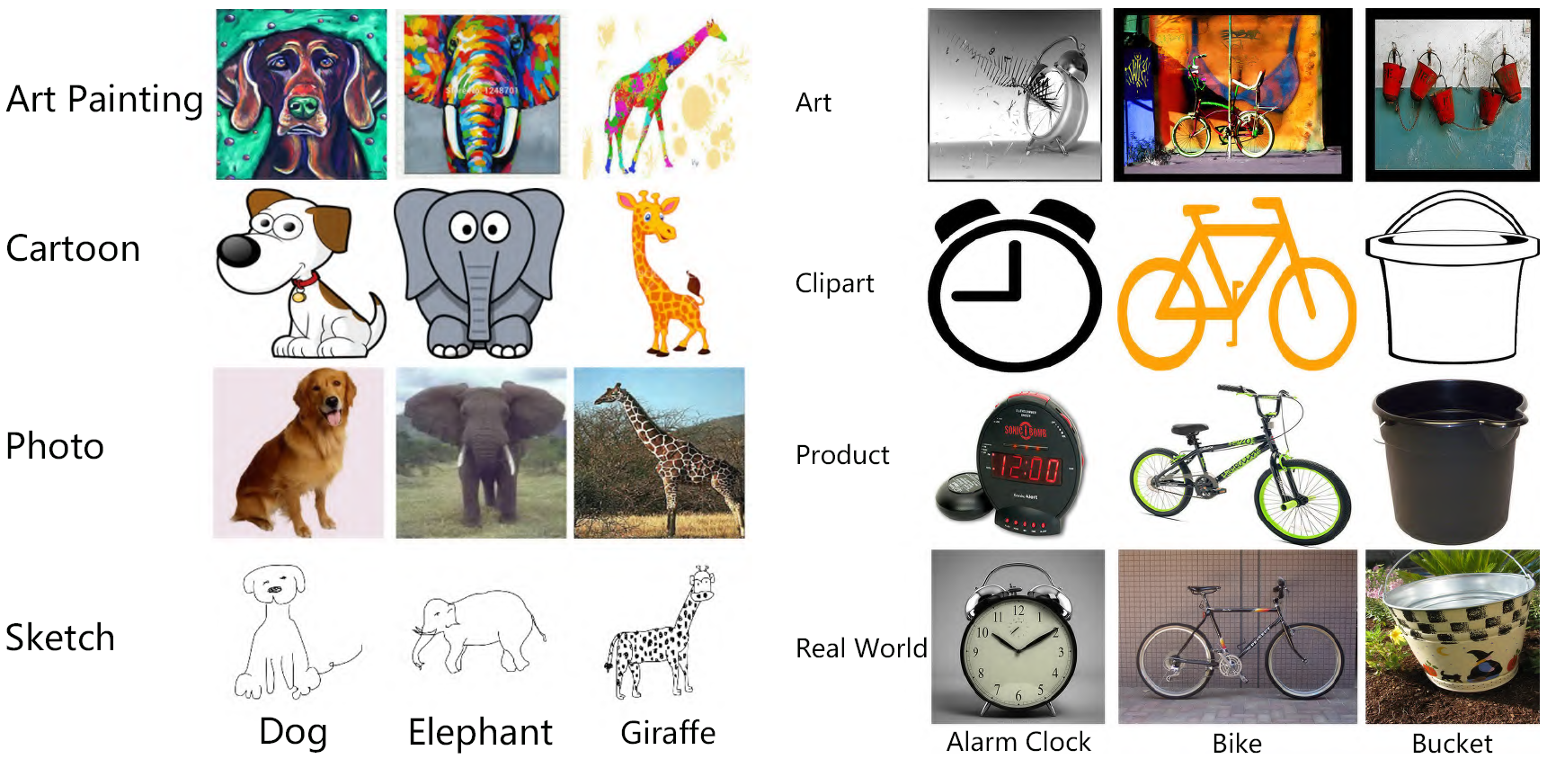
Results on Real-World Datasets

Slide 16
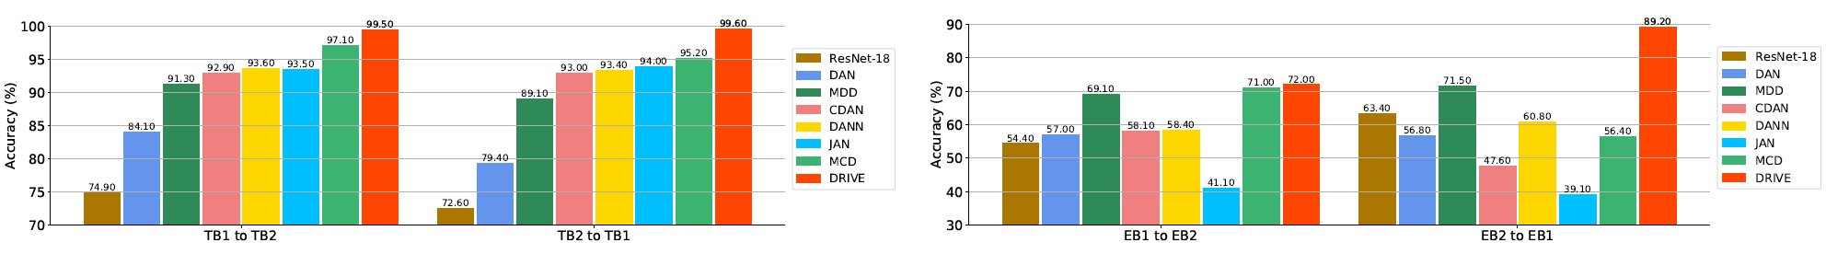
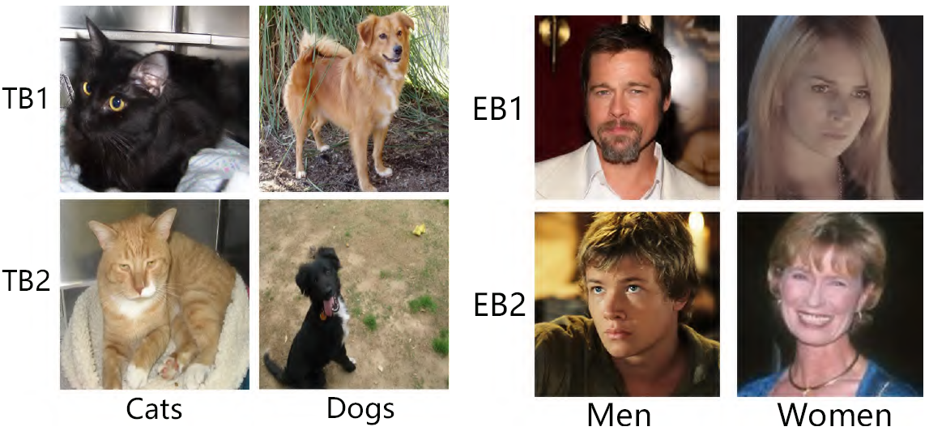
Results on Real-World Datasets

Slide 17
Conclusions
Build generalizable models is important for AI applications.
Domain generalization is one solution.
Causality techniques has been demonstrated to be useful in exploring invariant causal relations.
How to develop causality-inspired algorithms for enabling domain generalization and other machine learning problems.

Slide 18
References
[1] Goodfellow I J, Shlens J, Szegedy C. Explaining and harnessing adversarial examples[J]. arXiv preprint arXiv:1412.6572, 2014.
[2] Li H, Pan S J, Wang S, et al. Domain generalization with adversarial feature learning[C]//Proceedings of the IEEE Conference on Computer Vision and Pattern Recognition. 2018: 5400-5409.
[3] Carlucci F M, D'Innocente A, Bucci S, et al. Domain generalization by solving jigsaw puzzles[C]//Proceedings of the IEEE/CVF Conference on Computer Vision and Pattern Recognition. 2019: 2229-2238.
[4] Pearl J. Causality[M]. Cambridge university press, 2009.
[5] Hartford J, Lewis G, Leyton-Brown K, et al. Deep IV: A flexible approach for counterfactual prediction[C]//International Conference on Machine Learning. PMLR, 2017: 1414-1423.
[6] R. Singh, M. Sahani, and A. Gretton. Kernel instrumental variable regression. In Advances in Neural Information Processing Systems (NeurIPS), pages 4593–4605, 2019.
[5] A. Bennett, N. Kallus, and T. Schnabel. Deep generalized method of moments for instrumental variable analysis. In Advances in Neural Information Processing Systems (NeurIPS), pages 3564–3574, 2019.
[7] Yuan J, Ma X, Kuang K, et al. Learning Domain-Invariant Relationship with Instrumental Variable for Domain Generalization[J]. arXiv preprint arXiv:2110.01438, 2021.

Slide 19
Thank You!

